Slide 1



CONNEX SC

Slide 2
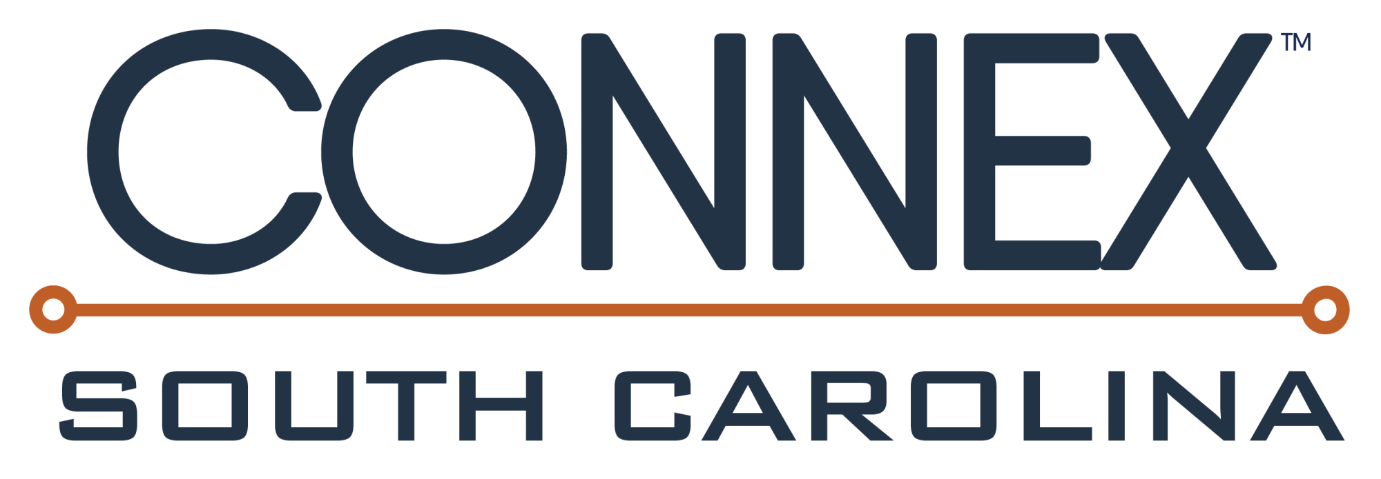


Built to shorten the supply chain and source local first – only US manufacturers
Promoted by the National Association of Manufacturers (NAM)
Provides opportunities for local suppliers to connect with OEMs
Administered by SCMEP

Slide 3
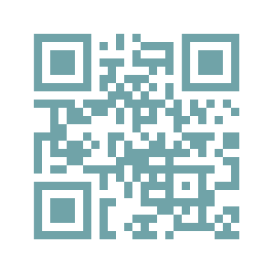

Find new and alternate suppliers.
Be found by potential customers.
Improve your company’s profitability today with trustworthy data, verified by SCMEP.
Customized profile highlighting your company’s unique capabilities
Sophisticated search engine to find suppliers by location, certifications, SBA-designations, and more
Exchange Center to post and respond to new business opportunities
Blacklisted supplier alerts
Supply-chain risk visualization tools
Notes:
SCMEP’s newest membership program is CONNEX SC. If you’ve heard about CONNEX SC, or if you are a member of CONNEX SC, you know that this is South Carolina’s ONLY manufacturer-exclusive B2B platform that allows manufacturers to find new and alternate suppliers, as well as be found by potential customers. What really sets CONNEX apart is that it is administered by the MEP centers, so only vetted manufacturers known by their local MEP are able to join. This makes CONNEX a reliable and trustworthy sourcing solution. Additionally, CONNEX SC can be a powerful resource for a manufacturer’s sustainability strategy.

Slide 4
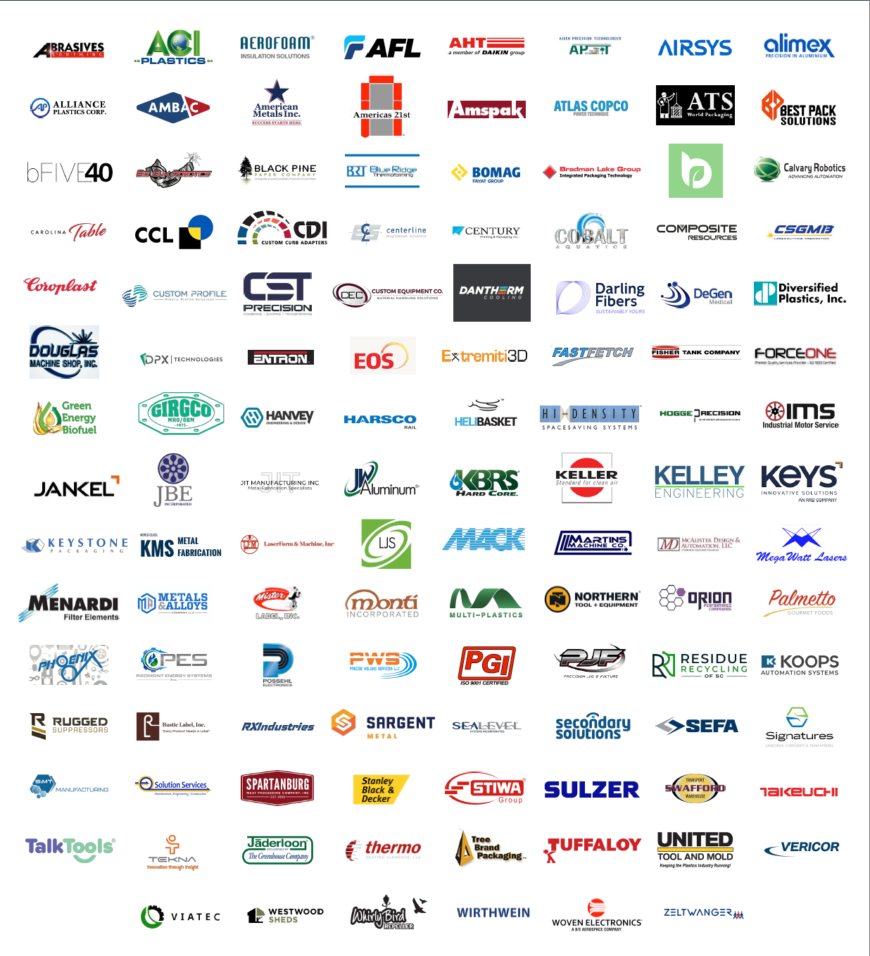
Who’s On CONNEX SC?
Notes:
With just under one year of launching CONNEX SC, we now have 160 companies on the platform. Several have already discovered new suppliers. With the support of SCDOC and SCMA, we only expect this program to grow and grow in the state.

Slide 5
OpExChange Members on CONNEX SC
3D Systems
Acutec Precision Aerospace
AEROFOAM USA LLC
AHT Cooling Systems USA
AIRSYS
ALIMEX PRECISION IN ALUMINUM INC
Allegiance Flag Supply
Ambac International Corp
AO Smith
Atlas Copco Power Technique
Auriga Polymers Inc
Belimed
Big Gun Robotics
BOMAG
Boost Mobile
Briteline Extrusion
Card Monroe
ClickFold Plastics
Coroplast Tape Corporation
Daedalus Industrial
Defense Engineering Services
Diversified Plastics Incorporated
Engineered Products LLC
era-contact USA, LLC
EuWe EUGEN WEXLER US Plastics Inc
FlexQube Inc
Floralife Inc
FN America LLC
Forged Path Automation
Harsco Rail
Heidelberg Materials
IKO Glass Fiber Inc
Industrial Motor Service
International Process Plants and Equipment (IPP)
IPS Packaging (Industrial Packaging Supplies)
Jankel Tactical Systems LLC
JBE Inc
Kion North America Corporation
Koops, Inc (SC)
LJS Solutions, LLC
Materials Research Group
McAlister Design and Automation LLC
Monti, Incorporated - Greenwood
New Horizon Shutters
PBI Performance Products
Performance Friction Corporation
Phoenix Specialty Mfg Company
Precise Welding Services LLC
Rico Industries
Rolls-Royce Solutions America Inc
Sargent Metal Fabricators
Savannah River Nuclear Solutions LLC
SC Dept of Corrections Division of Industries
Sealevel Systems Incorporated
Secondary Solutions Inc
SiMT
SixAxis LLC
Springfield Tool & Die
Stoll Industries
Sulzer Process Pumps (US) Inc
SWM International
Takeuchi
Trane Technologies
Transaxle Manufacturing of America
Tuffaloy Products Inc
Turn90
United Tool & Mold, Inc
Vericor Power Systems LLC
Wilbert Plastic Services - Easley
Wirthwein Fountain Inn, LLC
Only 30% of OpExChange Members are taking advantage of this FREE program!
Notes:
With just under one year of launching CONNEX SC, we now have 160 companies on the platform. Several have already discovered new suppliers. With the support of SCDOC and SCMA, we only expect this program to grow and grow in the state.

Slide 6

Statewide access funded for all SC Manufacturers through SC Dept of Commerce!
Nationwide access available for $650 / year.
228 SC manufacturers on the platform so far!
To join, visit SCMEP.ORG/CONNEX
Notes:
The best part of CONNEX is that statewide access to the program is sponsored by the SC Dept of Commerce. That means manufacturers can join for free and gain access to the database of over 3800 manufacturers in the state, as well as the federal postings in the exchange center. To gain nationwide visibility of over 160,000 manufacturers in the entire US, manufacturers can upgrade their profiles for $500/year.

