Slide 1
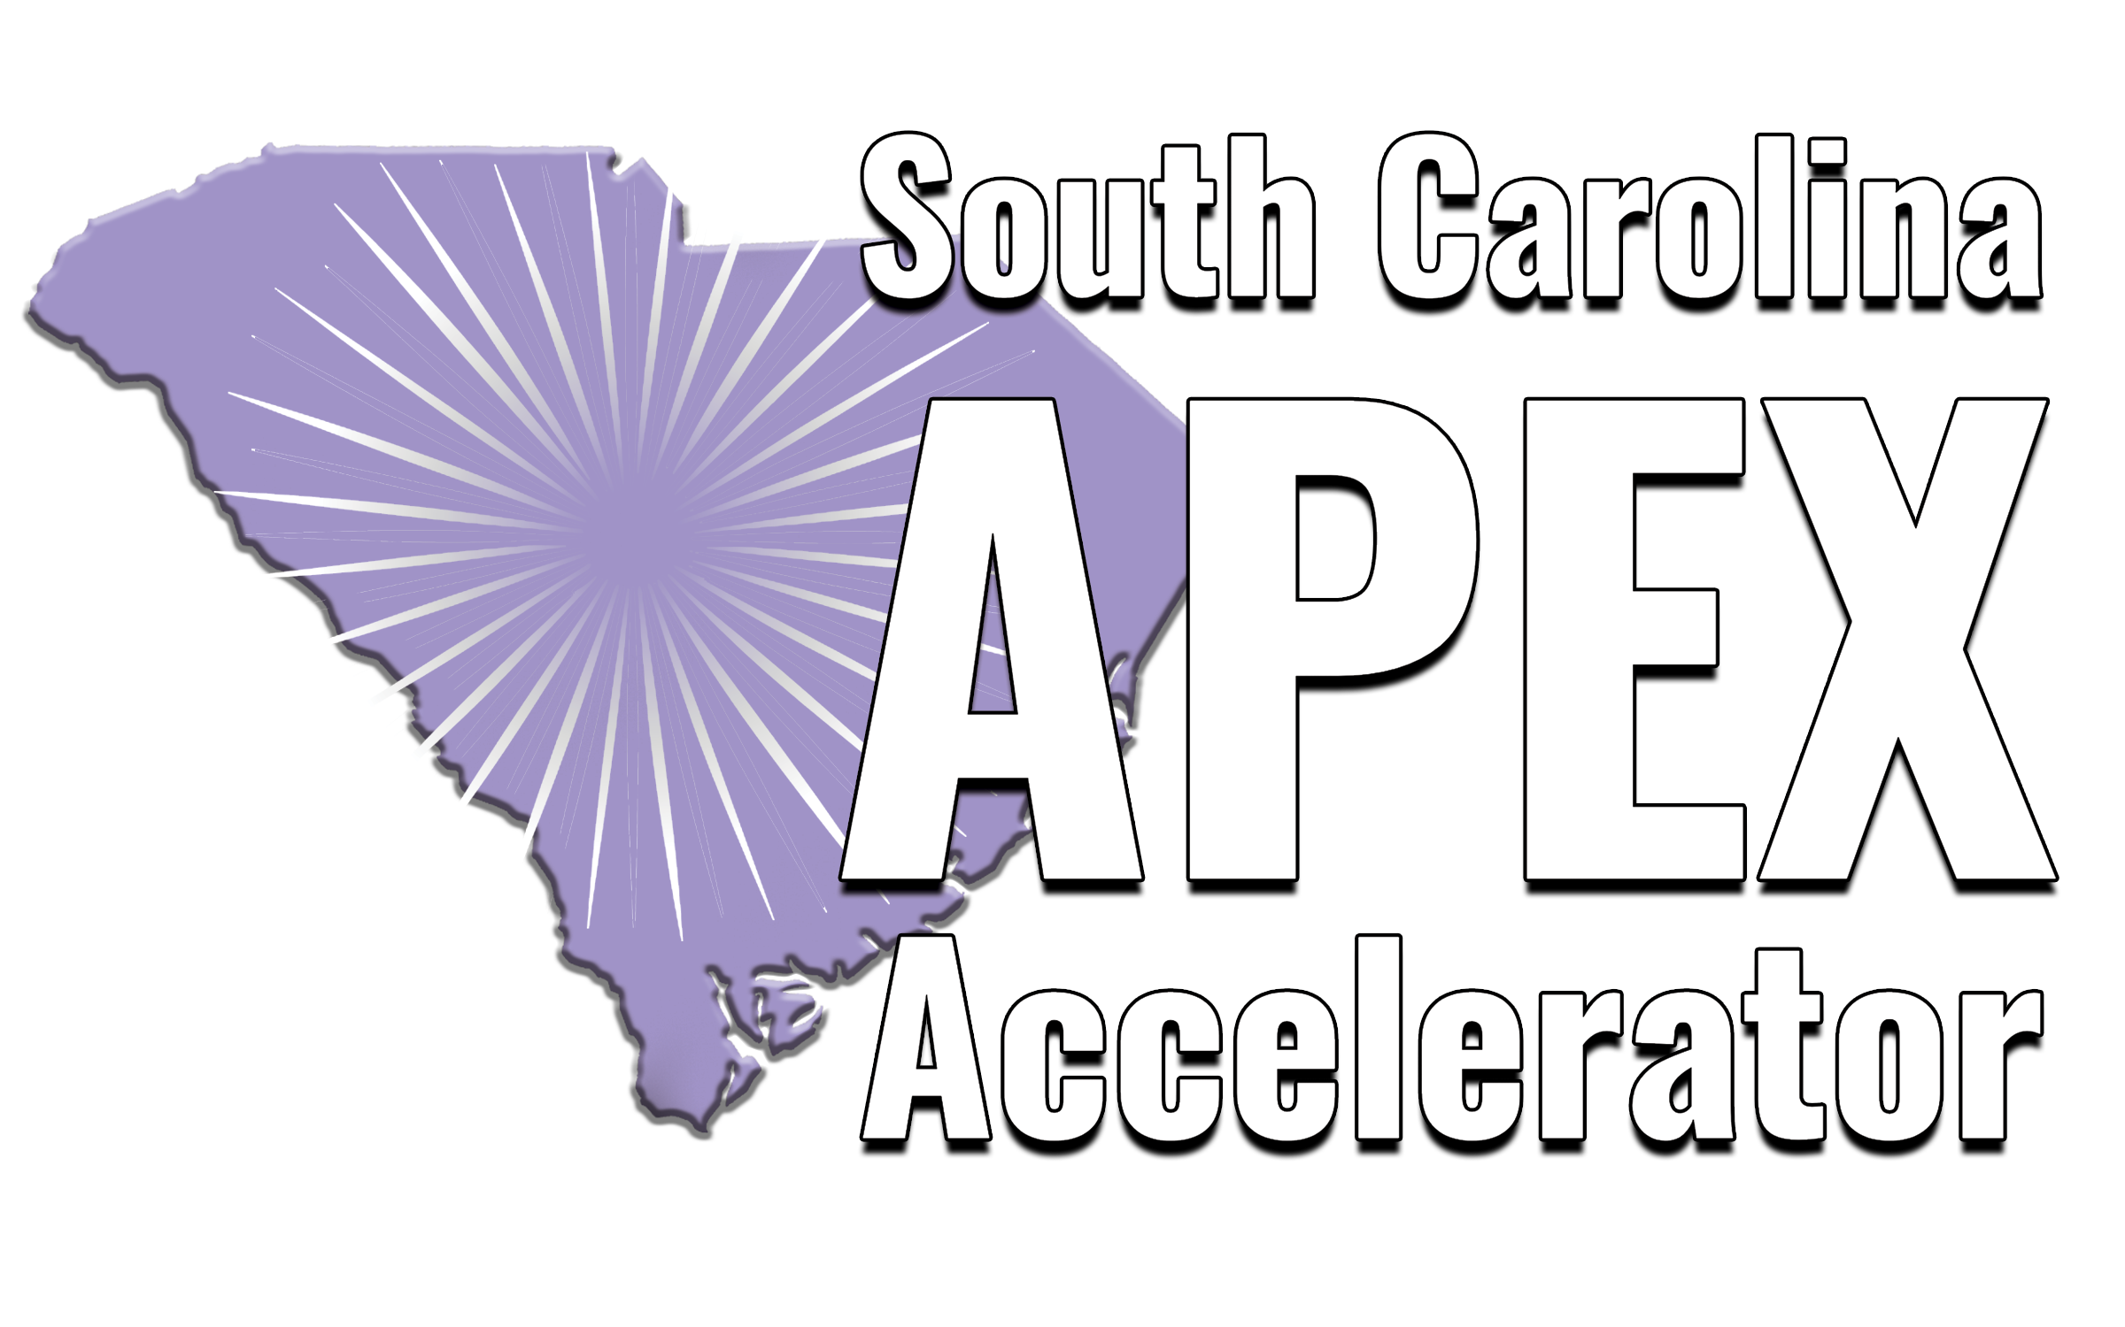
SC APEX and Manufacturing Growth: Leveraging Government Contract Opportunities

Slide 2
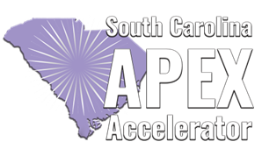
Our Impact and Services
OUR SERVICES
Estimated award dollars from September 2021 to March 2026
Technical Assistance - The identification, submission, and post-award management of federal, city, state, local, and education government contracting opportunities.
$726 million
DOD $431M
Federal Agencies $282M
State/Local $13M
Compliance - Aids the registration of federal/state/local procurement systems and certifications.
244
170
92
Bid-Matching - We provide access to federal, city, state, local and education government opportunities available for bid.
Veteran-Owned Small Business and Service Disabled VOSB
Disadvantaged/Minority Business Enterprise DBE/MBE
Historically Underutilized Business Zone (HUBZone)
96
37
Relationships - Marketing and relationship assistance for selling your products/services to government and prime/subcontractors.
Women-Owned Small Business and Economically Disadvantaged WOSB
8(a) Small Business
Training - SC APEX offers on-demand and virtual training for your whole team. New employees? No problem.

Slide 3
Are You Maximizing Your Growth Potential with Government Opportunities?
No-Cost Services
With us by your side, proceed confidently in government contracting with long-term support, at no cost.
Networking
We offer various training and networking opportunities for our clients, giving them access to opportunities.
Bridging the Gap
Opportunity
Be the first to know about DOD’s upcoming contracting opportunities.
During FY25, the U.S. government planned to spend $755B, 23% of which was goaled to small business.

Slide 4
Market Research
In FY26 to date, the following agencies have spent funds on manufacturing-related efforts and projects:
Dept of Defense
US: $58.38B
SC: $125.95M
Dept of Veterans Affairs
US: $9.50B
SC: $27.01M
Dept of Health and Human Services
US: $3.43B
SC: $225.12M
General Services Administration
US: $3.27B
SC: $4.76M
NASA
US: $1.79B
SC: $2.84M
Dept of Homeland Security
US: $1.24B
SC: $4.75M
Dept of Agriculture (USDA)
US: $997.98M
SC: $4.09M
Dept of Justice
US: $480.31M
SC: $1.46M

Slide 5
DOD Key Technology Areas
The following are considered six essential areas in building the Defense Industrial Base:
Applied Artificial Intelligence (AAI)- 541715, 541511, 541512, 334111
BioManufacturing (BIO)- 325414, 541711, 325412
Contested Logistic Technologies (LOG)- 336411, 336992, 488190, 541330
Quantum & Battlefield Information Dominance (Q-BID)- 334511, 541715, 334220, 517410
Scaled Directed Energy (SCADE)- 334511, 336414, 541715
Scaled Hypersonics (SHY)-336414, 336415, 336419
Government Spending Open Data | USAspending

Slide 6
Market Research – State/Local
The following SC state agencies have contracted for manufacturing:
State of SC Division of Procurement
County of Lexington, SC
City of Rock Hill, SC
SCDC Commissary Main Warehouse
SC Department of Corrections
SC Department of Transportation
SC Highway Patrol
NASPO ValuePoint

Slide 7
Potential Pathways
Cornerstone: Focuses on expanding and modernizing the DIB through the IBAS program (e.g., Machine Tools, Advanced Technology and Advanced Manufacturing, Industrial Base and Manufacturing Skills)
Advanced Technology International (ATI): Consortiums to aid in the coordination and execution of the nation’s most innovative research initiatives (e.g., American Metalcasting, Forging Defense Manufacturing, Aviation & Missile Technology, The Composites, and Defense Electronics)
Department of Defense Manufacturing Innovation Institutes: Connect manufacturers with national innovation institutes that support the rapid development and adoption of advanced manufacturing technologies for defense and commercial markets. Examples include additive manufacturing, digital manufacturing and cybersecurity, advanced materials, photonics, robotics, and bio industrial manufacturing
NASPO ValuePoint: Search tools to identify active state term contracts, purchasing trends, and determine eligibility requirements for participating entities and suppliers.

Slide 8
How SC APEX Can Provide Short-Term Support?
Government Contracting Readiness Assess business readiness for government contracting, including SAM.gov registration, NAICS/PSC alignment, socio-economic certifications, and compliance requirements (FAR 52.204-21 & CMMC)
Market Intelligence & Strategy Development
Identify agency buying trends, target opportunities, and potential competitors or partners within the manufacturing industry
Supplier Growth Connect with suppliers and manufacturers through access to our client and partner network
Past Performance Development Strengthen and document past performance and corporate experience to enhance contracting competitiveness

Slide 9
How Can SC APEX Provide Long –Term Support?
Bid & Proposal Support
Assistance with opportunity identification, go/no-go decision making, solicitation review, and proposal submission guidance
Training Support
Procurement and government contracting training opportunities for manufacturing business employees
Relationship Building
Support in developing connections with prime contractors, vendors, OEMs, and government agencies through outreach and networking

Slide 10
SC APEX Client Registration Process
Step 1: Sign up on SC APEX Accelerator (“Sign Up Now”)
Step 2: Create your account and enter business details
Step 3: Attend welcome/orientation webinar
Step 4: Receive counselor assignment

Slide 11

Questions?

